Slide 1
Wisconsin Department of Corrections
Employment Readiness in DOC Town Hall
Tuesday, March 22, 2022
Notes:
Okay, it looks like we’re ready to get started. Thank you all for joining us for today’s Virtual Town Hall on Employment Readiness in DOC, where we’ll be discussing the ways our agency actively seek out ways to promote collaboration and employment opportunities for individuals returning to the community from incarceration, and how they can be a valuable addition to the workforce.
​
My name is Zack Osell and I’ll be moderating today’s event. I’m a communications specialist in the Office of Public Affairs and one of the key responsibilities in my position is stakeholder engagement.
​
Before we move on, I want to go over one of the features we’re using today in Zoom Webinar – you should see a Question and Answer icon near the bottom of your screen. we’ll be looking at all questions submitted using this feature throughout today’s webinar, and we will have time near the end to open up the floor to our panelists to answer some of the questions that we receive. I also want to note that today’s session will be recorded and shared at a later date for those who are unable to attend today’s live event. As we’ve done in the past, we will post an FAQ document on our public website after the event that addresses the questions we don’t get to today.
​​
​
That’s all for me, I’m now going to turn it over to Secretary Carr for his opening remarks and some more information about our panel members for today’s topic.

Slide 2
Welcome and Opening Remarks
Kevin A. Carr, DOC Secretary

Slide 3
A Message from Governor Evers

Slide 4
A Message from DWD Secretary-Designee Amy Pechacek

Slide 5
Update on Work Release & COVID-19
Sarah Cooper, Division of Adult Institutions Administrator
Notes:
Okay, a big thank you to Governor Evers and Secretary Designee Pechacek for those messages. We will now hear from our panel members within the Division of Adult Institutions, starting with Administrator, Sarah Cooper. Sarah, I’ll let you take over from here.

Slide 6
Education Programming
Lisa Reible, Office of Program Services Director

Slide 7
Program Initiatives that Support Employment
DAI Primary Programs
Cognitive Based Interventions for Employment
Second Chance Pell Programs
Apprenticeship Opportunities
Career Technical Education Programs
Entrepreneur in Training Program

Slide 8
Work Release Programs
Maria Silao-Johnson, Winnebago Correctional Center Superintendent Julie Ustruck Wetzel, Milwaukee Women's Correctional Center Superintendent

Slide 9
Work Release Programs
The Work Release Program has placed thousands of individuals into jobs since its inception in 1965.
Work Release Functions:
Protects public interest by collecting court fees, child support, and victim restitution.
Provides a work history/personal references.
Promotes reintegration into the community.
Allows for partnerships with community employers as a workforce.

Slide 10
Work Release Programs
The Wisconsin Department of Corrections has 17 male and 2 female minimum security facilities strategically placed throughout the state.
As a minimum facility, a portion of the population will be granted the privilege of Work Release.

Slide 11
Work Release Expectations
Program needs addressed
Positive institutional adjustment
Positive work history and evaluations at the center
Review and approval process for employment sites
Work release guidelines

Slide 12
Getting Involved with Work Release
Employers looking for more information on work release can contact the correctional center in their area directly.
Navigate to doc.wi.gov, then click on adult facilities under quick links to find a correctional center in your area.
You can also contact the DOC General Mailbox for assistance (DOCGeneral@wisconsin.gov).

Slide 13
Experience with Work Release
Katie Barry, Human Resources/Production Manager, Staffing Synergies
Notes:
Okay, thank you DAI panelists. Next, we have the privilege of hearing from Katie Barry, who is a human resources and production manager for Staffing Synergies. She’ll be talking about some of her experiences partnering with the DOC through work release. Katie, you can go ahead whenever you’re ready.

Slide 14
Reentry Programming
Becky Heth, Employment Program Manager,
Reentry Unit
Notes:
Thank you, Katie. Next, we’ll be hearing from Becky Heth, who is the Employment Program Manager within DOC’s Reentry Unit. Becky, I’ll let you take over.

Slide 15
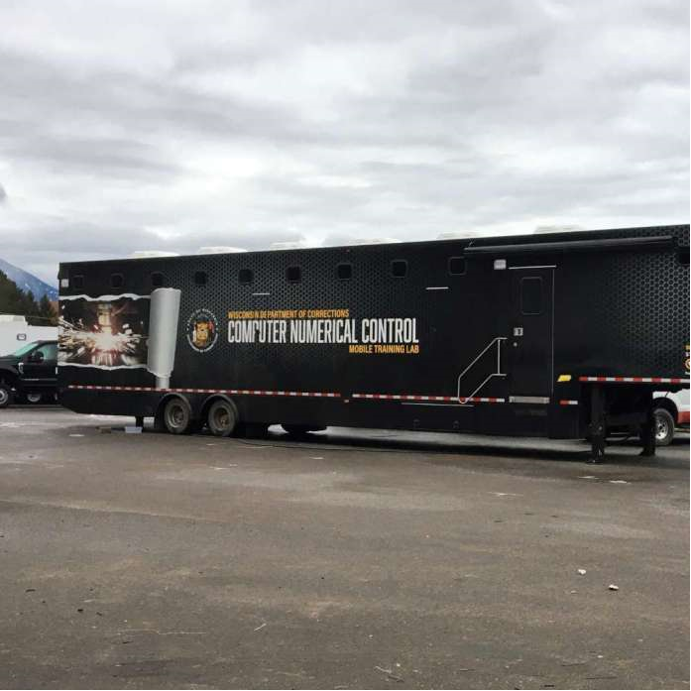
DOC Mobile Training Labs
RCI: CNC Mobile lab, Gateway Technical College
TCI: Welding Mobile lab, Moraine Park Technical College*
NLCI: Electrical Mechanical Mobile lab, Western Technical College*
JCI: CNC Mobile lab, Western Technical College
RYOCF: Mechatronics, Gateway Technical College*
Notes:
Reentry has purchased three Mobile Training Classrooms in collaboration with DWD noted by asterisk These labs have been placed at medium security prisons inside the perimeter fence for training in high demand fields.
These mobile classrooms are inside the perimeter fence in medium security prisons.
providing additional capacity to train PIOC in high demand fields which will aide them in securing employment upon release.
Last year the CNC Operator Mobile lab pictured here, was delivered to Jackson Correctional Institution and instruction will begin next month.
Lastly DOC contracts with the local technical college for onsite instruction.

Slide 16
Career and Technical Education Academies (CTE)
Wisconsin Correctional Center System (WCCS)
Kenosha Correctional Center
Gateway- CNC
Marshall E. Sherrer Correctional Center /Felmers O. Chaney Correctional Center
MATC-Welding
Oregon Correctional Center/Thompson Correctional Center
Madison College- Carpentry Techniques & Electrical Mechanical Maintenance
John C. Burke Correctional Center
MPTC-Welding
Gordon Correctional Center
Northwood Tech- Refrigeration Essentials
McNaughton Correctional Center
NATC -Heavy Machine Operator
Sanger B. Powers Correctional Center
NWTC- Industrial Maintenance
Wisconsin Women’s Correctional Center System (WWCS)
Robert E. Ellsworth Correctional Center
Gateway- CNC
Notes:
During the past 5+ years, WIDOC has expanded on its existing programming to offer several short-term CTE training opportunities to better prepare persons in our care for employment in high-demand fields. WIDOC contracts with local WTCS member colleges to provide these training academies, which often occur on campus through Study Release and culminate in the individual earning a technical diploma or certificate within the span of approximately 2-4 months.

Slide 17
Short-Term Career & Technical Education Initiatives
WI-DOC Coordinates with local technical colleges and utilizes labor market trends in determining field of study for PIOC.
Contract with locate WTCS member colleges to provide these training academies, which often occur on campus and culminate in the individual earning a technical diploma or certificate in approximately 2-4 months.
Notes:
During the past 5+ years, WIDOC has expanded on its existing programming to offer several short-term CTE training opportunities to better prepare persons in our care for employment in high-demand fields. WIDOC contracts with local WTCS member colleges to provide these training academies, which often occur on campus through Study Release and culminate in the individual earning a technical diploma or certificate within the span of approximately 2-4 months.

Slide 18
Institution Job Centers

Slide 19
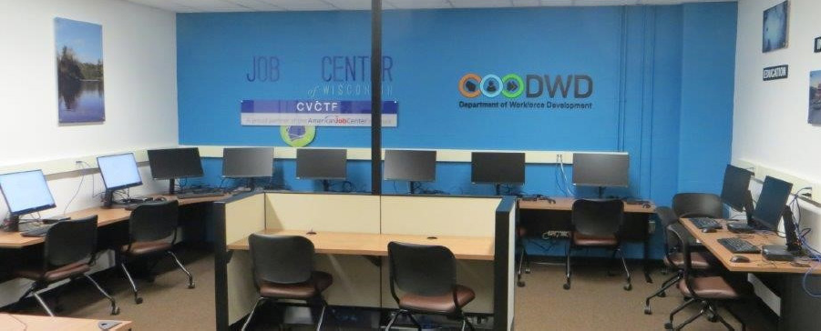
DOC Job Centers
In 2018 the Departments of Corrections (DOC) and Workforce Development (DWD) created the first institution based job center in the state of Wisconsin in 2018 at Oakhill Correctional Institution (OCI). Since then, the DOC and DWD have worked together to successful open a total of ten institution job centers and one mobile job center.
Robert E. Ellsworth Correctional Center (REECC)
Racine Youthful Offender Correctional Facility (RYOCF)
Racine Correctional Institution (RCI)
Milwaukee Women’s Correctional Center (MWCC)
Taycheedah Correctional Institution (TCI)
Kettle Moraine Correctional Institution (KMCI)
Chippewa Valley Correctional Treatment Facility (CVCTF)
Jackson Correctional Institution (JCI),
New Lisbon Correctional Institution (NLCI-Mobile)
Oakhill Correctional Institution (OCI)
Prairie du Chien Correctional Institution (PDCI)
Notes:
During the past 5+ years, WIDOC has expanded on its existing programming to offer several short-term CTE training opportunities to better prepare persons in our care for employment in high-demand fields. WIDOC contracts with local WTCS member colleges to provide these training academies, which often occur on campus through Study Release and culminate in the individual earning a technical diploma or certificate within the span of approximately 2-4 months.

Slide 20
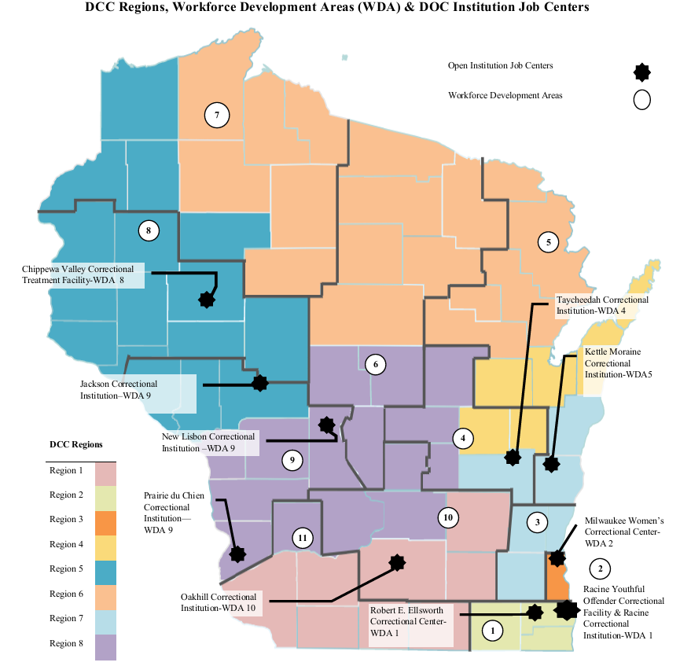
Notes:
Robert E. Ellsworth Correctional Center (REECC)
Racine Youthful Offender Correctional Facility (RYOCF)
Racine Correctional Institution (RCI)
Milwaukee Women’s Correctional Center (MWCC)
Taycheedah Correctional Institution (TCI)
Kettle Moraine Correctional Institution (KMCI)
Chippewa Valley Correctional Treatment Facility (CVCTF)
Jackson Correctional Institution (JCI),
New Lisbon Correctional Institution (NLCI-Mobile)
Oakhill Correctional Institution (OCI)
Prairie du Chien Correctional Institution (PDCI)

Slide 21
Windows to Work (W2W)

Slide 22
W2W Mission Statement
The Windows to Work program will promote self-sufficiency for individuals returning to the community through the development of constructive skills and the modification of thought processes related to criminal behavior.
Notes:
During the past 5+ years, WIDOC has expanded on its existing programming to offer several short-term CTE training opportunities to better prepare persons in our care for employment in high-demand fields. WIDOC contracts with local WTCS member colleges to provide these training academies, which often occur on campus through Study Release and culminate in the individual earning a technical diploma or certificate within the span of approximately 2-4 months.

Slide 23
Program Goals
Reduce recidivism for participants released from incarceration.
Increase employment placement opportunities for participants.
Increase length of employment retention for participants.
Increase wages of participants.
Notes:
During the past 5+ years, WIDOC has expanded on its existing programming to offer several short-term CTE training opportunities to better prepare persons in our care for employment in high-demand fields. WIDOC contracts with local WTCS member colleges to provide these training academies, which often occur on campus through Study Release and culminate in the individual earning a technical diploma or certificate within the span of approximately 2-4 months.

Slide 24
Program Description
Windows to Work is a pre- and post-release program designed to address criminogenic needs that can lead to recidivism.
WI DOC contracts with each of Wisconsin’s 11 Workforce Development Boards (WDB) to provide, or subcontract to provide, a Windows to Work Program at selected state correctional institutions or county jail facilities.
Instruction begins in the institution or county jail site approximately three to 12 months prior to a participant’s release and continues in the community for approximately 12 months following the participant’s release.
Following a participant’s release from incarceration, the Coach will collaborate with the Division of Community Corrections (DCC) Agent to assist participants with job search and job retention activities.
Notes:
During the past 5+ years, WIDOC has expanded on its existing programming to offer several short-term CTE training opportunities to better prepare persons in our care for employment in high-demand fields. WIDOC contracts with local WTCS member colleges to provide these training academies, which often occur on campus through Study Release and culminate in the individual earning a technical diploma or certificate within the span of approximately 2-4 months.

Slide 25
Program Sites
Division of Adult Institution Sites
Chippewa Valley Correctional Treatment Facility
Columbia Correctional
Fox Lake Correctional
Green Bay Correctional
Jackson Correctional
Kettle Moraine Correctional
Milwaukee Secure Detention Facility
New Lisbon Correctional
Oakhill Correctional
Oshkosh Correctional
Prairie du Chien Correctional
Racine Correctional
Red Granite Correctional
Racine Youthful Offender Correctional
Stanley Correctional
Taycheedah Correctional
Waupun Correctional
Wisconsin Secure Program Facility
County Jail Sites
Adams
Douglas
Rock
Washington
Waukesha
Wood
Notes:
During the past 5+ years, WIDOC has expanded on its existing programming to offer several short-term CTE training opportunities to better prepare persons in our care for employment in high-demand fields. WIDOC contracts with local WTCS member colleges to provide these training academies, which often occur on campus through Study Release and culminate in the individual earning a technical diploma or certificate within the span of approximately 2-4 months.

Slide 26
CTE Graduate – Shawna Houk
Notes:
Becky to introduce Shawna

Slide 27
DCC Programs Supporting Employability Pre & Post Release
Joselyn López, Corrections Services Supervisor Division of Community Corrections
Notes:
Thank you so much for being with us today and sharing your experiences, Shawna. We really can’t thank you enough for taking the time out of your busy day to share such a powerful and inspirational story with us all.
We’ll now move on to our next panelist today, Josey Lopez, who serves as the Corrections Services Supervisor within the Division of Community Corrections. Josey, I’ll turn it over to you.

Slide 28
DCC Probation & Parole Agent Role
Identify needs for Employment Readiness
Develop Case Plans and action steps with clients
Address criminogenic needs first to ensure clients are ready for employment
Educate clients on employment opportunities
Act 123 – Certificates of Qualification for Employment (CQE)
Refer clients to:
Community Corrections Employment Program (CCEP)
Contracted services in the community
Non-DOC community programs

Slide 29
CCEP Overview
Community Corrections Employment Program (CCEP) is a statewide program designed to assist clients in obtaining the skills necessary to gain and maintain employment in a competitive work environment.
Employment Program Coordinators (EPC) Role
Pre-Release Connections
Assess & place participants based on level of skill and work readiness.
Three focus areas:
Work experience
On-the-job training
Educational and training assistance

Slide 30
DCC Employment Program Coordinator Contact Information
Region | Name | Counties Served | Contact Information
Region 1 | Carly Huag | Dane, Dodge, Grant, Green, Iowa, Jefferson, Lafayette, Rock | Carly.Haug@wisconsin.gov
Region 2 | Tom Durgom | Kenosha, Racine, Walworth | Richard.Durgom@wisconsin.gov
Region 3 | Jessica Goodwin | Milwaukee | JessiaM.Goodwin@wisconsin.gov
Region 4 | Rodney Owens | Brown, Calumet, Door, Kewaunee, Outagamie, Winnebago | Rodney.Owens@wisconsin.gov
Region 5 | Andrew Nicolet | Barron, Burnett, Buffalo, Chippewa Falls, Clark, Douglas, Dunn, Eau Claire, Jackson, Pepin, Pierce, Polk, Rusk, St. Croix, Trempealeau, Washburn | Andrew.Nicolet@wisconsin.gov
Region 6 | Jon Hanson | Ashland, Bayfield, Florence, Forest, Iron, Langlade, Lincoln, Marathon, Marinette, Menominee, Oconto, Oneida, Price, Shawano, Sawyer, Taylor, Vilas | Jon.Hanson@wisconsin.gov
Region 7 | John Schild | Fond du Lac, Manitowoc, Ozaukee, Sheboygan, Washington, Waukesha | JohnB.Schild@wisconsin.gov
Region 8 | Sara Hohenstein | Adams, Columbia, Crawford, Green Lake, Juneau, La Crosse, Marquette, Monroe, Portage, Richland, Sauk, Vernon, Waushara, Wood | Sara.Hohenstein@wisconsin.gov

Slide 31
DCC Contracted Services
Agreements in place with Technical Colleges throughout Wisconsin
Outpatient Services for Vocational and Work-Related Services
Partnerships with Department of Workforce Development
Community Based-Residential Services Program
Criminogenic Needs
Employment Readiness Skills
Other skills to help sustain employment long-term

Slide 32
Live Q+A Session
We want to help answer your questions!
Submit any last-minute questions using the Q&A feature near the bottom of your screen
We will be posting an FAQ document on MyDOC with written responses for the questions we don’t get to today
Notes:
Okay, thank you Josey and to all of those who shared with us today.
We’ll now transition to the next part of today’s event, our live Q & A Session. We’ve been reviewing the questions you’ve submitted using the Q&A feature and we will now take some time to answer those questions.
Here’s one final reminder to submit any last-minute questions before the conclusion of today’s town hall.
I’m going to give Superintendent Silao (SEE-la-o) Johnson an opportunity to answer our first question today. The question reads, “What initiatives are happening to allow those that are in work release programs

Slide 33
Closing Remarks
Find more information about past and upcoming town halls: Visit doc.wi.gov/TownHalls
To provide further input and town hall feedback: Watch your inbox for a survey
For access to recordings, transcripts, FAQs and more: Keep an eye on our Town Halls webpage for more information
Notes:
Before we wrap up, I want to note that you can find information about upcoming town halls on DOC’s Town Halls landing page on our public website. This page can be found at doc.wi.gov/TownHalls –
We also ask that you watch your inbox for an email with a link to our survey, which will give you all an opportunity to provide us with feedback on today’s event
And then here is one final reminder that we will have access to recordings, transcripts, FAQs and more on our public website for you all to review in the coming weeks – again, these will all be posted to our town halls landing page.
I will now turn it over to the Secretary to close out today’s town hall.

Slide 34
Thank You!
DOC.WI.GOV/TOWNHALLS
Notes:
We look forward to continuing these conversations
I hope you all continue to stay safe
Thank you and see you next time.

