Slide 1
Brown County Secure Residential Care Center for Children and Youth (SRCCCY)
Erik Pritzl, Kevin Brennan, Dannel Skalecki, Brian Laurent
August 19, 2019

Slide 2
Utilization and Facility Overview

Slide 3
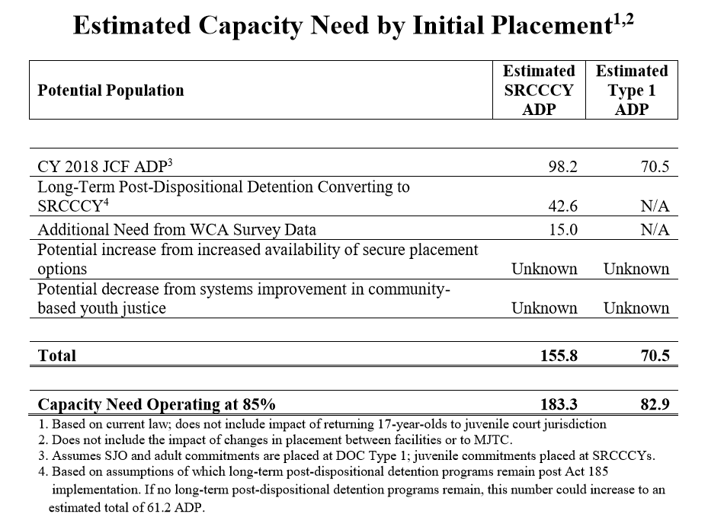
Statewide SRCCCY Population Need
Source: Secure Juvenile Facility Population Capacity Analysis: Considerations for Act 185 Implementation –Submitted 5/20/19 to the Juvenile Corrections Grant Committee

Slide 4
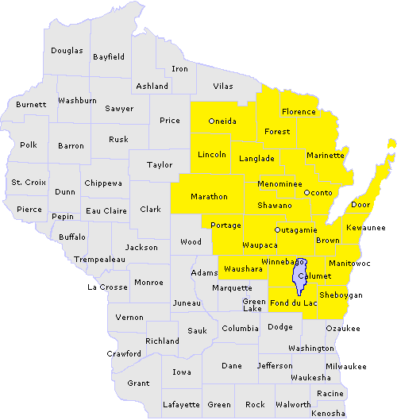
Regional SRCCCY Need
Brown County Estimated Utilization
4 Correctional placements for youth
4 Type II placements
3 LAUNCH placements (alternative to corrections)
Regional Utilization
Reviewing data from a 21 county area around Brown County, there was an average daily population of 19 youth in corrections from 2010-2017¹.
There are likely youth currently placed in residential care centers (RCC’s) who could be placed in an SRCCCY if available.
¹Juvenile Corrections Population Data—Submitted 9/14/2018 to Juvenile Corrections Study Committee

Slide 5
Brown County Facility Overview
Two Services Proposed:
24 Bed Secure Residential Care Center for Children and Youth (SRCCCY)
32 Bed Secure Detention Facility
Serving Males and Females in Each Facility
Current Brown County Services:
15 Bed Secure Detention (Sheriff’s Office)
Collaborative 180 Day Program—LAUNCH (Sheriff’s Office and Health & Human Services)
Serving Males and Females in Each Facility

Slide 6
Cost Breakdown—SRCCCY and Secure Detention

Slide 7
Construction Cost Breakdown

Slide 8
Estimated Operational Costs

Slide 9
Current and Proposed Rates
Juvenile Corrections Rates
Estimated Rate for Brown County SRCCCY
Current Wisconsin Daily Correctional Rate: $532-July 1,2019
Future Wisconsin Daily Correctional Rate: $615 on July 1, 2021
Estimated to be $550-$685
Utilization and Census
Needs of the Youth
Will vary based on occupancy

Slide 10
SRCCCY-Programming

Slide 11
Program Goals
Collaborate, coordinate, and Communicate a comprehensive system of care for every youth
Encompass Formal and Informal supports.
Strengthen Familial relationships and community partnerships
Support and advocate cultural competency
Promote and direct family engagement
Integrate and Individualize treatment plans
Utilize stakeholder support
Promote and offer skill development around core competencies
Collaborate treatment planning towards rehabilitation and Healing

Slide 12
Pre-Admission
Formal meeting with primary case manager, youth, parent and formal stakeholders.
Attain Releases of information (PHI)
Review pre-admission (YASI) risk and Needs Assessment, supporting assessments previously completed i.e.; mental health, medical, educational
Review Pre-Cans assessment
Narrative collected by the parent and youth of perceived needs and strengths
Review E-WISACWIS services and placement history
Collect and Review the Court report
Review program handbook and program expectations with parent and youth
Discuss goals and day to day program operations

Slide 13
Admission
Review updated YASI Assessment
Review medication administration/ Health Services
Review CANS Assessment
Complete a neurosequential therapeutic assessment/ mental Health Clinician
Complete a physical and oral health check up
Review school transcripts
Administer a pre-placement self assessment ( completed by each youth)
Schedule a formal treatment team meeting within 10-15 days of admission Meet the staff

Slide 14
Cultural Competency and Diversity
Expand LAUNCH Advisory Council: Actively recruit for cultural diversity
Connect with Community Resources
Use Existing Working Relationships
Local Tribes
Casa ALBA Melanie
Non-Profits—Gathering Place, Better Days Mentoring, My Brother’s Keeper
Department Experience
COMSA (Somali Community)
Green Bay Refugee Task Force
Hmong Center of Green Bay

Slide 15
Individual Treatment
House Assigned
Mental Health Clinician
House Case Manager
Daily Point Sheets
Adult Mentor
Monthly Progress Reviews
Youth

Slide 16
Education
School social worker will review all student transcripts prior to or within 72 hours of admission.
A student’s IEP will be reviewed and addressed at the time of admission. A formal review is able to occur at the treatment team meeting that occurs 10-15 days following admission.
Each student will have full day of school starting at 08:15 a.m.- 02:30 p.m.
The school social worker will be the liaison to the home community and school
Multiple constructed classrooms have been identified to support the individualized learning needs as well as expressed behaviors
Educational progress review will occur at the formal monthly reviews as part of the treatment team planning

Slide 17
Programming & Groups
Youth
Resiliency Group
(Community Recovery Model)
Self-Esteem Group
(I am Worth it)
Anger Management
(Aggression Replacement Training)
Thinking Change
(Carey Guides/BITS)
Recreation Group
(Cardio/Non-Cardio/Yoga)
Vocational Group
(Career Inventory/Workforce Development)
Independent Living Group
Daniel Memorial Assessment/Career Inventory

Slide 18
Transitions
Moving Toward Growth and Healing:
Each youth will petition to the treatment team at the monthly reviews prior to their official program discharge 60-90 days
Youth who are approved to transition along with the county case manager will move to our transition dorm
These dorms will have accommodations/and incentives and will resemble more of a normalized experience of home
Each youth who is able to enter this transitional phase will also be expected to take a leadership role as a facility coach for new admitted residents

Slide 19
Data and Tracking
Plan is to review to each graduate of the program 12-15 months:
Review of long term incarcerations, waiver, and any new county referrals
Use E-WiSACWIS to track further referrals and types
Each youth will complete a self-assessment screen prior to leaving
All data will be reported annually to the State of Wisconsin on current numbers served and outcomes achieved

Slide 20
Approvals & Support
Presented to Human Services Committee in 2019
Regular updates in reports to Human Services Board and Committee
Meetings with County Executive
Formal approval would be requested prior to accepting grant funding
Regional meeting with County Executives and Human Services Directors
Discussions at Northeast Region Director Meetings in 2019

Slide 21
Variances & Reductions
Variances
No variances in request
Estimated to meet requirements of DOC 347
Reductions & Cost Savings Measures
Reducing scope of project
Reducing capacity of project

Slide 22
Questions

