Slide 1
Dane County Juvenile Court Program
Secure Residential Care Center presentation to DOC Grant Committee
John Bauman, Juvenile Court Administrator and Ed Pearson, Superintendent
August 19, 2019

Slide 2
Located at 210 Martin Luther King Jr. Blvd. Rm 200 Madison, WI
Total current facility is 28,000 sq. ft.
Juvenile Detention contains 24 co-ed beds across three sleeping units
Proposed additional SRCC space is 11,000 sq. ft. indoor and 2,400 sq. ft. outdoor recreation

Slide 3
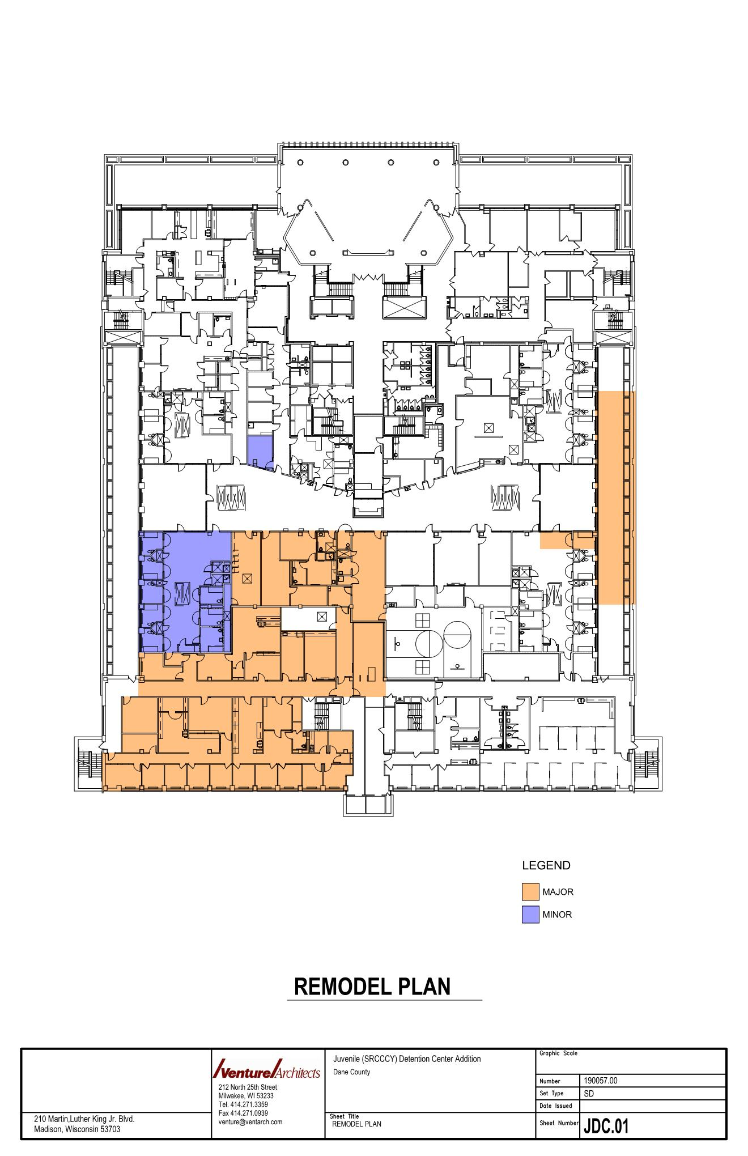
Current floor plan

Slide 4
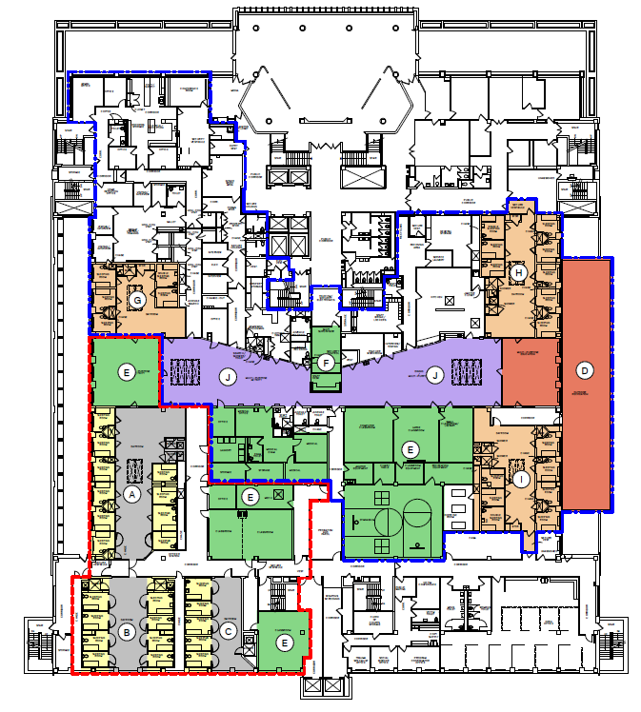
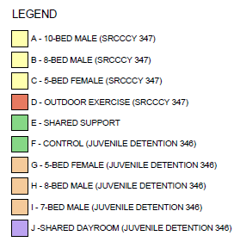
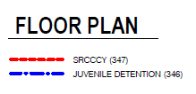
Floor layout and plans
18 male beds across 2 units with 5 bed additional capacity. 12-14 Dane youth.
3-4 girl beds in 1 unit with 2-3 bed additional capacity. 3-4 Dane youth.
Shared gym, dining, visitation, outdoor recreation, general purpose space
Separate classrooms, sleeping, programming space

Slide 5
Actual & Estimated Project Schedule
DESIGN |  |  |  |  |  |  |  | BIDDING |  |  |  |  | CONSTRUCTION
2019 |  |  |  |  |  |  |  | 2020 |  |  |  |  |  |  |  |  |  |  |  |  |  |  | 2021
Q2 |  |  | Q3 |  |  | Q4 |  |  |  | Q1 |  |  |  | Q2 |  |  | Q3 |  |  | Q4 |  |  | Q1 |  |  | Q2
1
2
5
9
10
11
12
13
4
7
3
6
14
8
 | Dane County Letter of Intent Submitted
 | Start of Design
 | Draft Grant Application Due
 | Finish Schematic Design Phase
 | Finish Design Development Phase
 | Final Grant Application Due
 | Grants Determined
 | Finish Construction Documents Phase
 | Let Request for Bids
 | Construction Bids Due
 | Construction Phase I – Outside Existing Secure Perimeter
 | Construction Phase II – Inside Existing Secure Perimeter
 | Ready for Occupancy
 | Mandated Deadline
1
9
2
10
3
11
4
5
12
6
13
7
14
8

Slide 6
Issues for discussion
Variances/cost reduction-347.10(2) furnishings/fixtures, self-contained breathing apparatuses, sally ports, direct supervision, co-located
Assessment/evaluation/data collection-social emotional learning, recidivism, placement stability, trauma, satisfaction, education
Daily rate-unknown, but will work with other counties to set a range for all that allows flexibility but avoids competition
Project costs-will be available by mid to late September
Outdoor space
Questions?

Slide 7
Thank you
John Bauman bauman.john@countyofdane.com
608-283-2925
Edjron Pearson pearson.edjron@countyofdane.com
608-283-2926

