Slide 1
Building a Racine County SRCCCY
Jonathan Delagrave, County Executive
Hope Otto, Human Services Director
Ed Kamin, Juvenile Detention Superintendent

Slide 2
“
To create a secure and therapeutic environment that applies contemporary
principles of juvenile behavioral modification and educational practices to improve outcomes for our young adults in the juvenile justice system
“
- Hope Otto, Director of Racine County Human Services
Notes:
Our vision dictates how we align our resources, funding, and programmatic direction- important to ground us in our work

Slide 3
A Youth-First Racine County
75%
1st
4.5
ACE youth do not receive felony charges within one year of completion
In State of Wisconsin to develop 180/365 program
Evidence-Based, Trauma-Informed Programs
Average credits earned by ACE participants in 170 days
Expanded, comprehensive medical and behavioral health services
Interactive Journaling | MindUP | Aggression Replacement Therapy
Notes:
We’re very proud of our successful youth justice programming- our outcomes stand out as one of the top programs in the State. Racine County has 25% recidivism to Lincoln Hills 99%, 4.5 credit earned in ACE versus ½ credit in 18 months in Lincoln Hills

Slide 4
Elevating Local Success to Support Regionalization
First in State in 2003
Required judiciary buy-in and statutory changes
Local success led to regional interest
Act 185 provides us the opportunity to take present programming and facility to the next level and expand regionalization
Keeps youth close to home
Access to local supports
Allows for construction of modern, state-of-the-art facility
Notes:
Approximately 70% of youth outside Milwaukee reside in Southern/Southeastern WI

Slide 5
Local Support
Other Priorities
Community
Space for volunteers and community-based quarters
Re-Entry
Contingency re-entry planning
Restorative Justice
Family
Family-centered healing and education
Family
Separate quarters
Classtime
Full school day of 8:30 a.m. – 3:30 p.m.
Beds
60-64 beds with separate boys and girls spaces
Training
Services
Diversity
Vocational and technical certifications
Evidence-based juvenile justice services, ex: trauma-informed care, resiliency, gang diversion
Diverse detention staff
= One Vote
Community Input, Youth Justice Advisory Committee
Notes:
We felt community participation was critical throughout the decision making process to gauge community support surrounding the future of our Juvenile detention Center. County Exec created a task force whose feedback helped to develop our current proposal including important discussions around location, overall design, and critical services and partnerships.
Diversity of staff was identified as a top priority > we currently employ diverse staff- over 60% people of color but our community goal is to have it reflect the youth in our care.

Slide 6
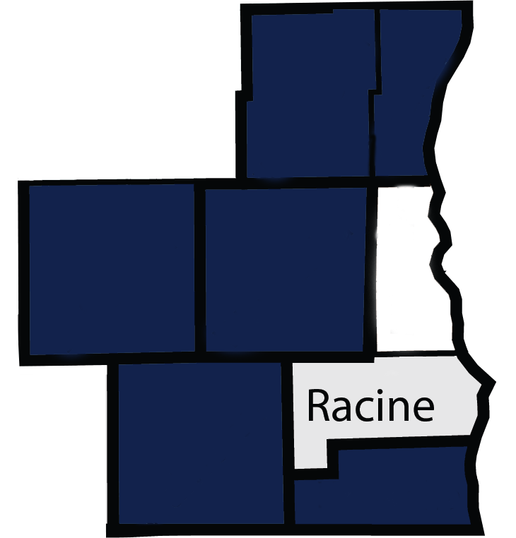
Regional Support
Ozaukee
Washington
Includes six partnering
counties
Jefferson
Waukesha
As well as education, law enforcement, and judicial letters of support
Walworth
Kenosha
Notes:
We have a longstanding history of operating in a regional capacity-with all of our neighboring counties who have written letters of support and intend to enter into MOUs.

Slide 7
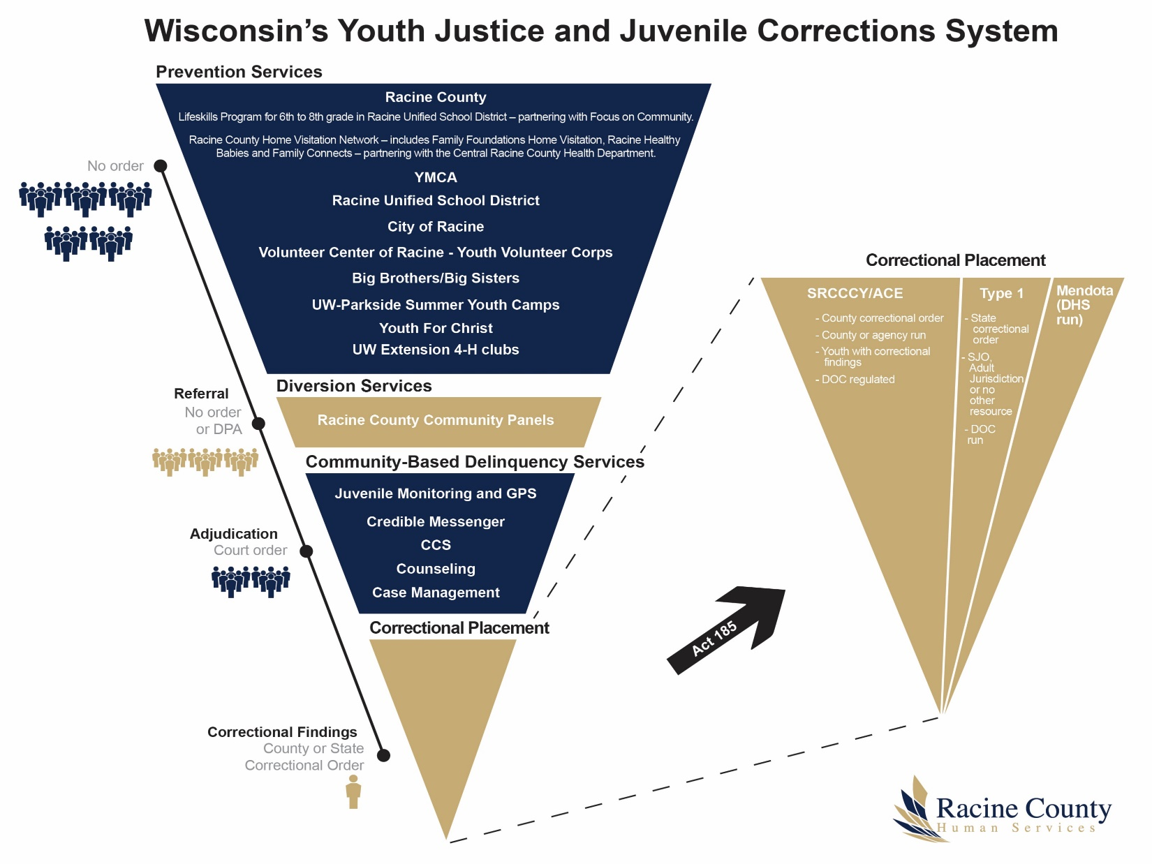
1/3 of apprehensions are diverted from formal court system
Notes:
One of our favorite slides created by DOC is the inverse pyramid highlighting the strong prevention and early intervention efforts that help to avoid formal court proceedings and sentencing. We are program rich and have been extremely effective in diversion- over 1/3 of all apprehensions are diverted through community panels, defered prosecution, and counsel and release.

Slide 8
Current Plan: Space Limitations
New
48 beds
@ 68K sq. ft
Old
119 beds
@ 22K sq. ft
At roughly 185 sq. ft per youth,
the old model cannot accommodate outdoor space nor adequate programming
Notes:
Our current facility has fantastic programming with an antiquated and tired facility. Currently imbedded in Human Services building, our current structure limits our ability to accommodate adequate programming.

Slide 9
Co-location is essential to minimize building costs and maximize program outcomes
2X
Administration
Costs without
co-location
2X
Staffing
2X
Programming
2X
Facilities

Slide 10
Future Space Needs
20%
20% Growth
Anticipated across County services and programming within next ten years
30%
10%
Growth in
Workforce
Solutions
Growth in
Economic
Support
30%
Growth in behavioral health services

Slide 11
Current Plan: A Daily Rate
Existing infrastructure and sophisticated programming already in place
Recognize local funding challenges
Increase current cost to reflect expanded programming and staffing
Maintained existing levy commitment
**Working with other County SRCCCY’s to develop unified rate

Slide 12
State Need > Regional Capacity
Racine
32
>
Dane
29
Wisconsin
183.3
M
K
E
54
Brown
22
Total: 137
Notes:
Statewide capacity analysis conducted show that the current need exceeds our regional capacity. It’s imperative for a facility our size in our region to be funded

Slide 13
Measurable Outcomes
01
Reduce recidivism rate
02
Increase educational attainment of high school credentials
03
Increase vocational credits for youth 16 years and older
Notes:
We believe strongly in data informed decision making and accountability through sophisticated data analytics- county investing in a Performance and Analytics division- will work to develop reasonable but aggressive outcomes for our facility.

Slide 14
“
To create a secure and therapeutic environment that applies contemporary
principles of juvenile behavioral modification and educational practices to improve outcomes for our young adults in the juvenile justice system
“
- Hope Otto, Director of Racine County Human Services
Notes:
As we started with our vision, we want to end with recapping why we’re here and where we want to go. We have the plan, talent, and local support to construct and operate an exemplary facility

